Slide 1
GZ81 Naganata
Project Overview

Slide 2
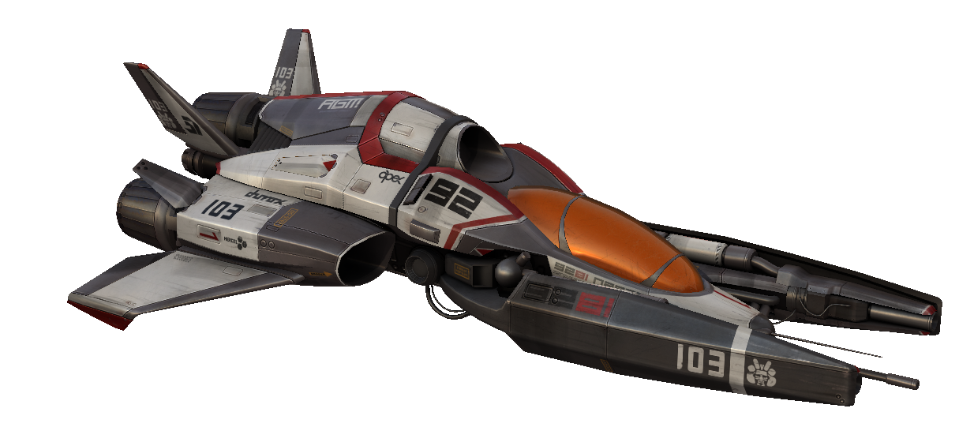

Slide 3
Project Overview
First design to final ingame model
Focus on
Design
Modeling
Textures/materials

Slide 4
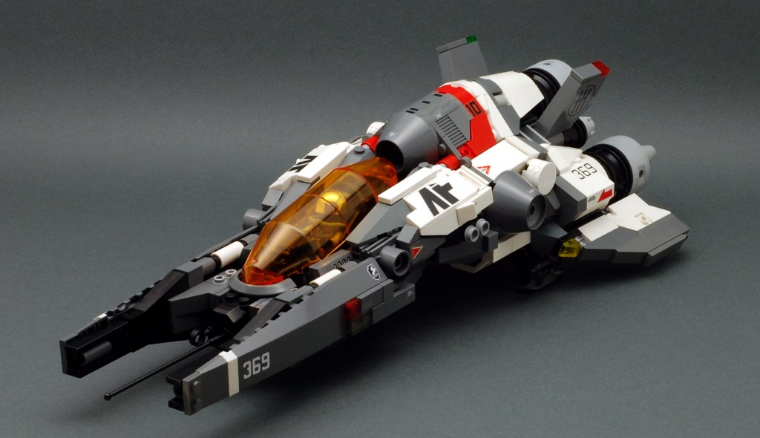
Design Idea/Concept
Lego!

Slide 5
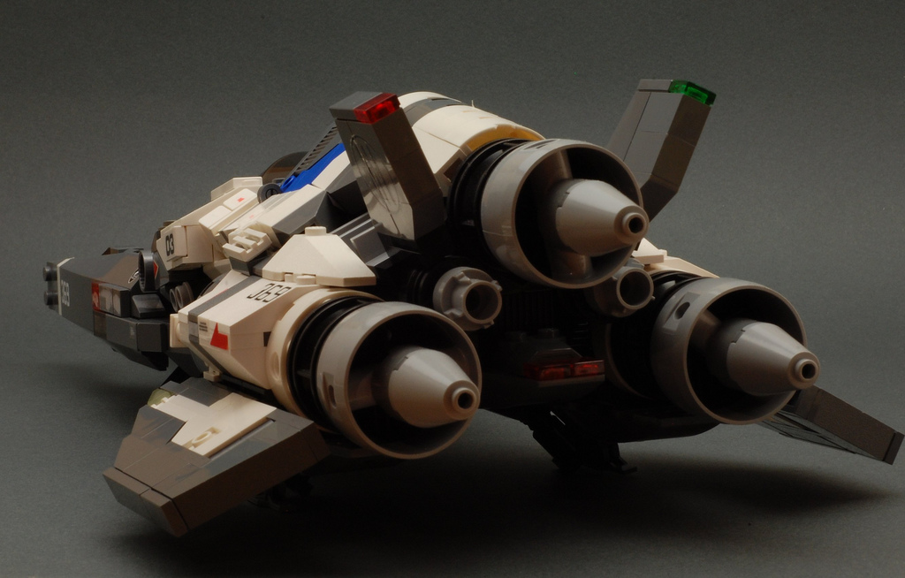
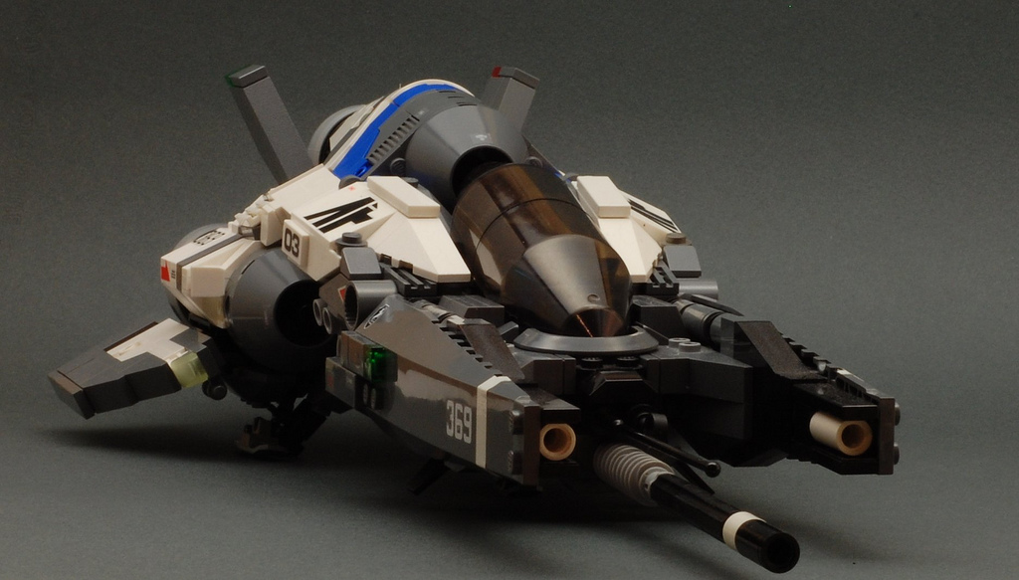
MOC by “DasNewten”

Slide 6
Design Idea/Concept
Lego shapes are not realistic
Too blocky
Studs
Connections are simple
Surface flow
Needs slight redesign
“3D-ify”

Slide 7
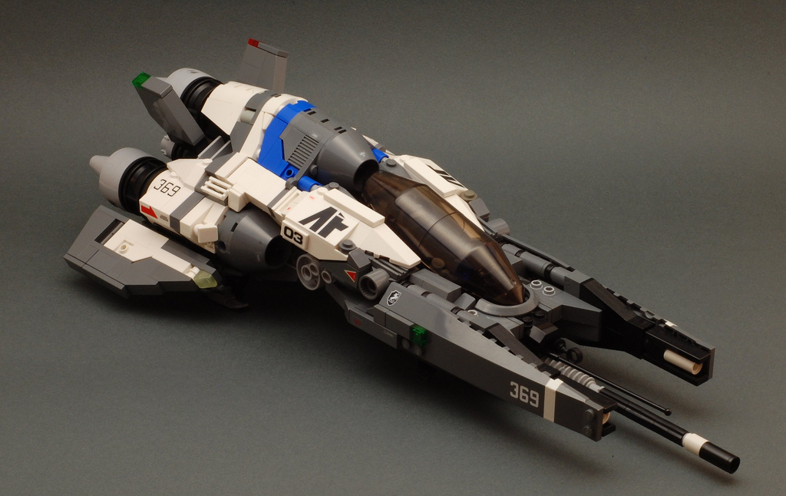
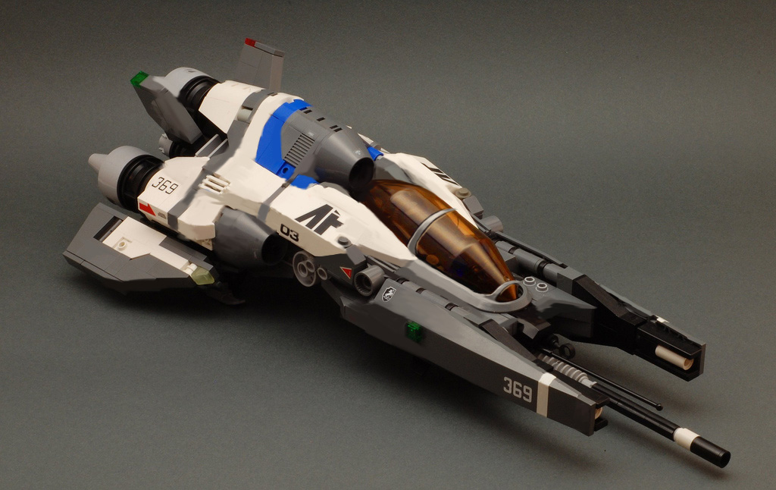
Lego Overpaint

Slide 8
Design Idea/Concept
Reference!
Fictional design requires ref for realism!
“Shape reference”
Specific design language
Smooth, flowing panels
Techy, greebled details
Contrasting colors and graphics
Fictional design reference!

Slide 9
District 9

Slide 10
District 9

Slide 11
District 9

Slide 12
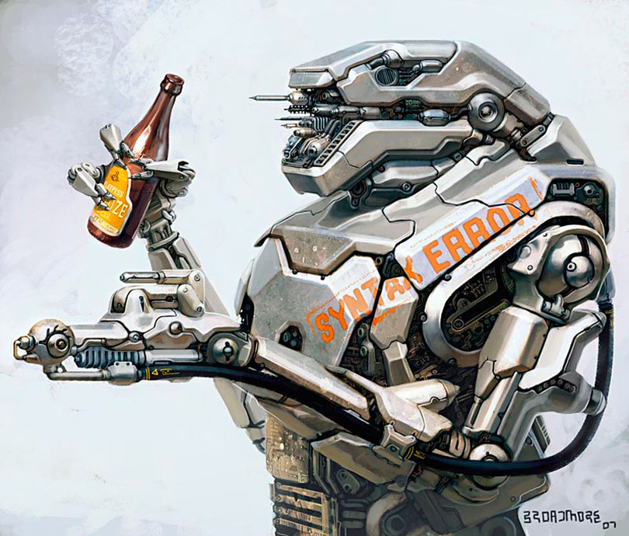
Greg Broadmore

Slide 13
Homeworld

Slide 14
Homeworld

Slide 15
Homeworld

Slide 16
Mass Effect 2

Slide 17
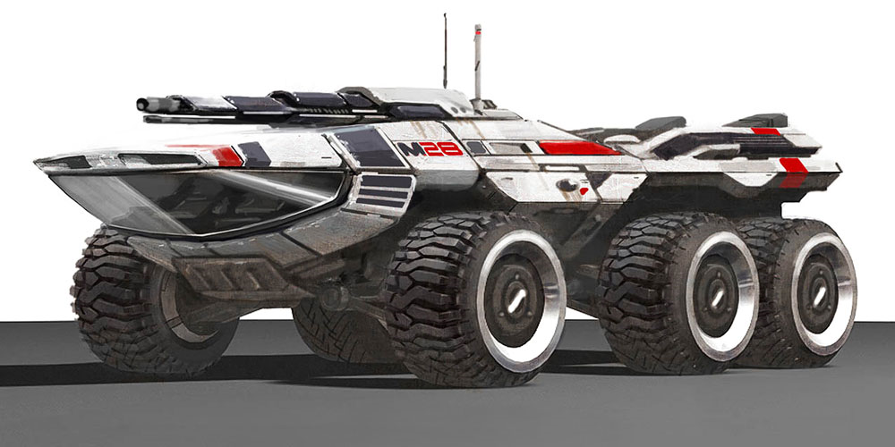
Mass Effect 2

Slide 18
Normandy SR2

Slide 19
Design Idea/Concept
Graphic Design reference
Paintjob needs to be special!
WipeOut / Designers Republic
Leri Greer (District 9)
Bold shapes & Colors
Pop Culture Influence

Slide 20
WipeOut Paintjobs

Slide 21
WipeOut Paintjobs

Slide 22
WipeOut Paintjobs

Slide 23
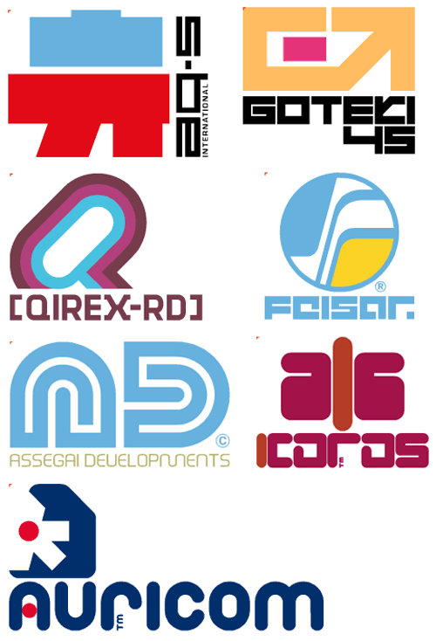
Designers Republic

Slide 24
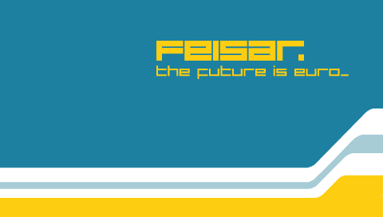
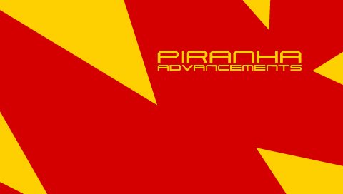
WipeOut Teams

Slide 25
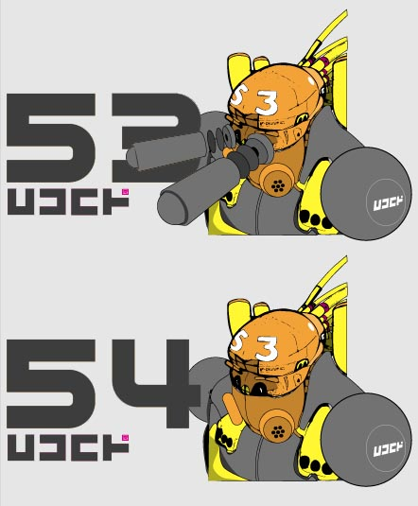
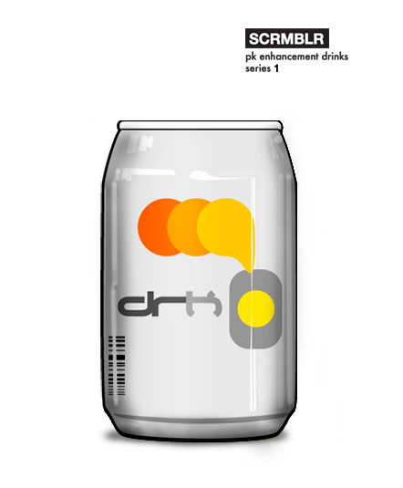
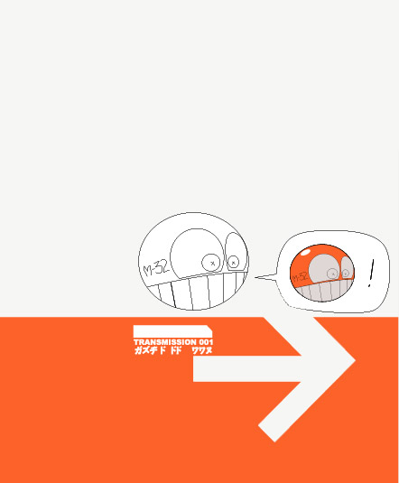
Leri Greer

Slide 26
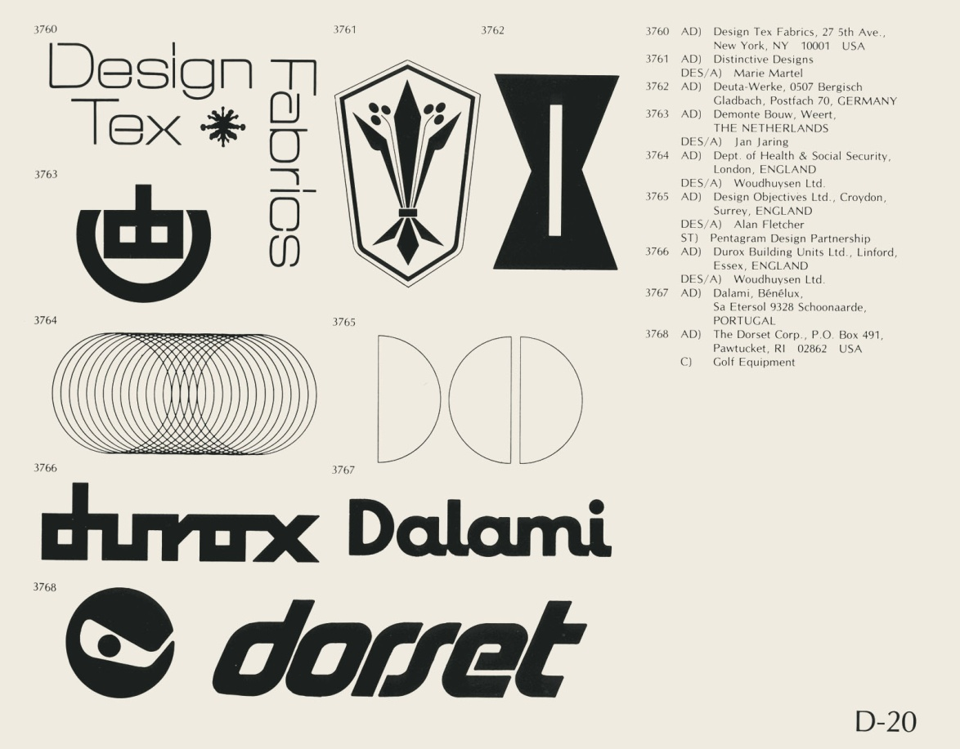
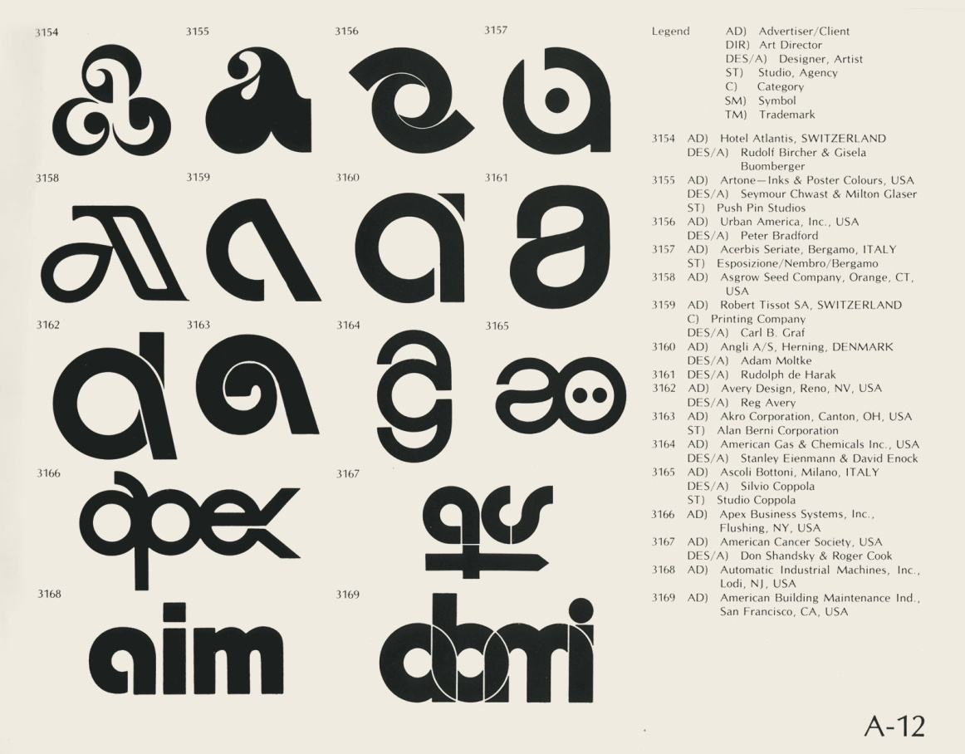
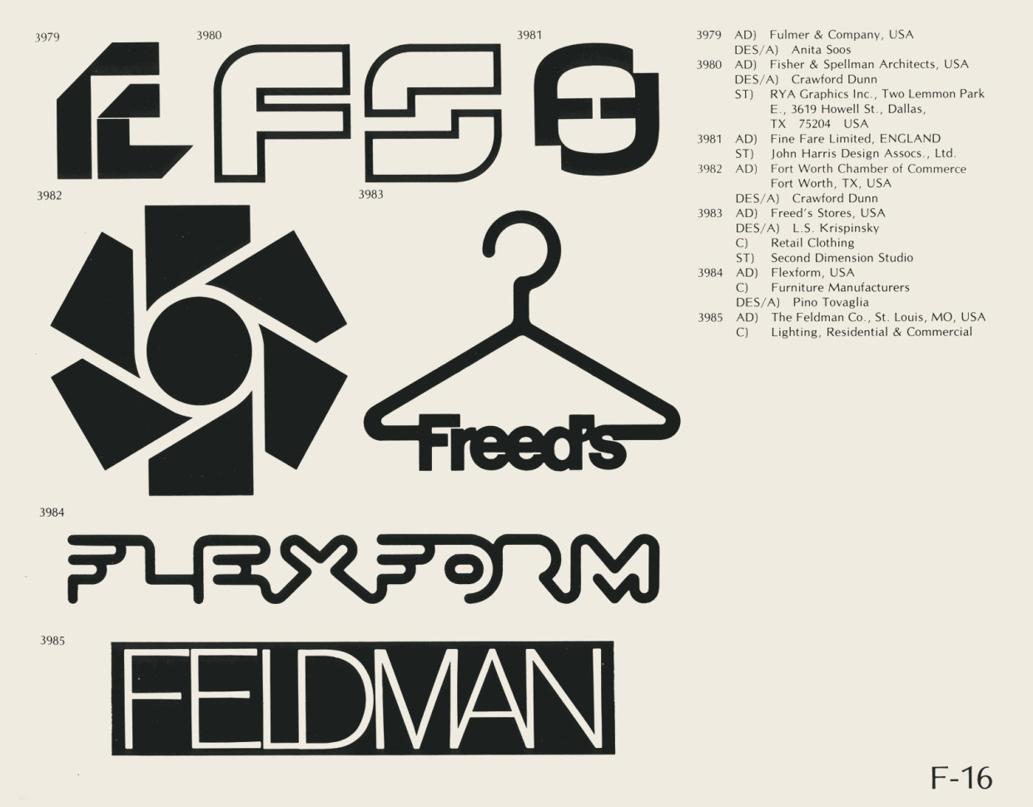
Logo Catalog

Slide 27
Design Idea/Concept
Material/detail reference
For exact surface properties
Small details to add interest
Technical accuracy
Real world ref only!

Slide 28
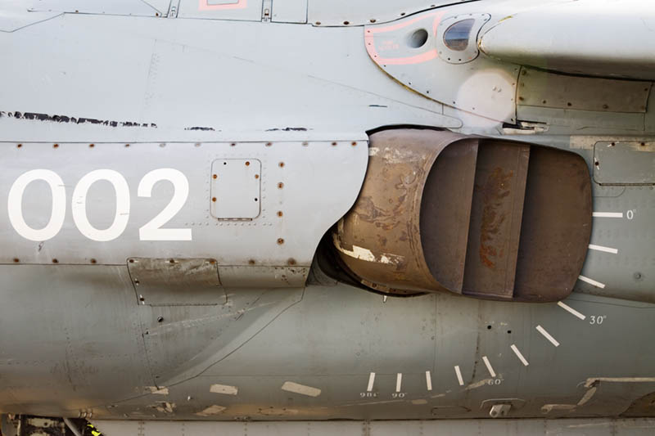
Airplane decals

Slide 29
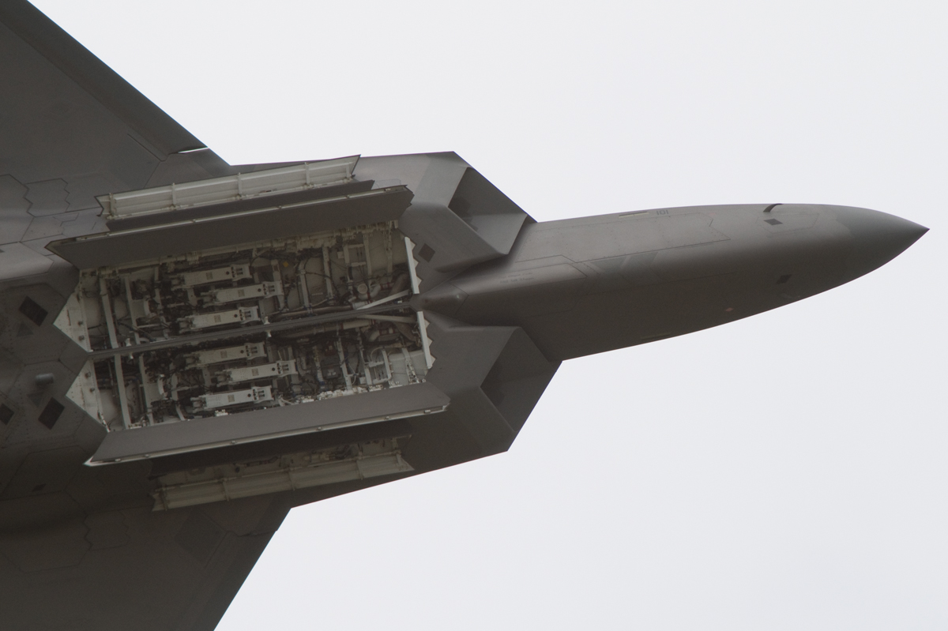
YF22 weapon bays

Slide 30
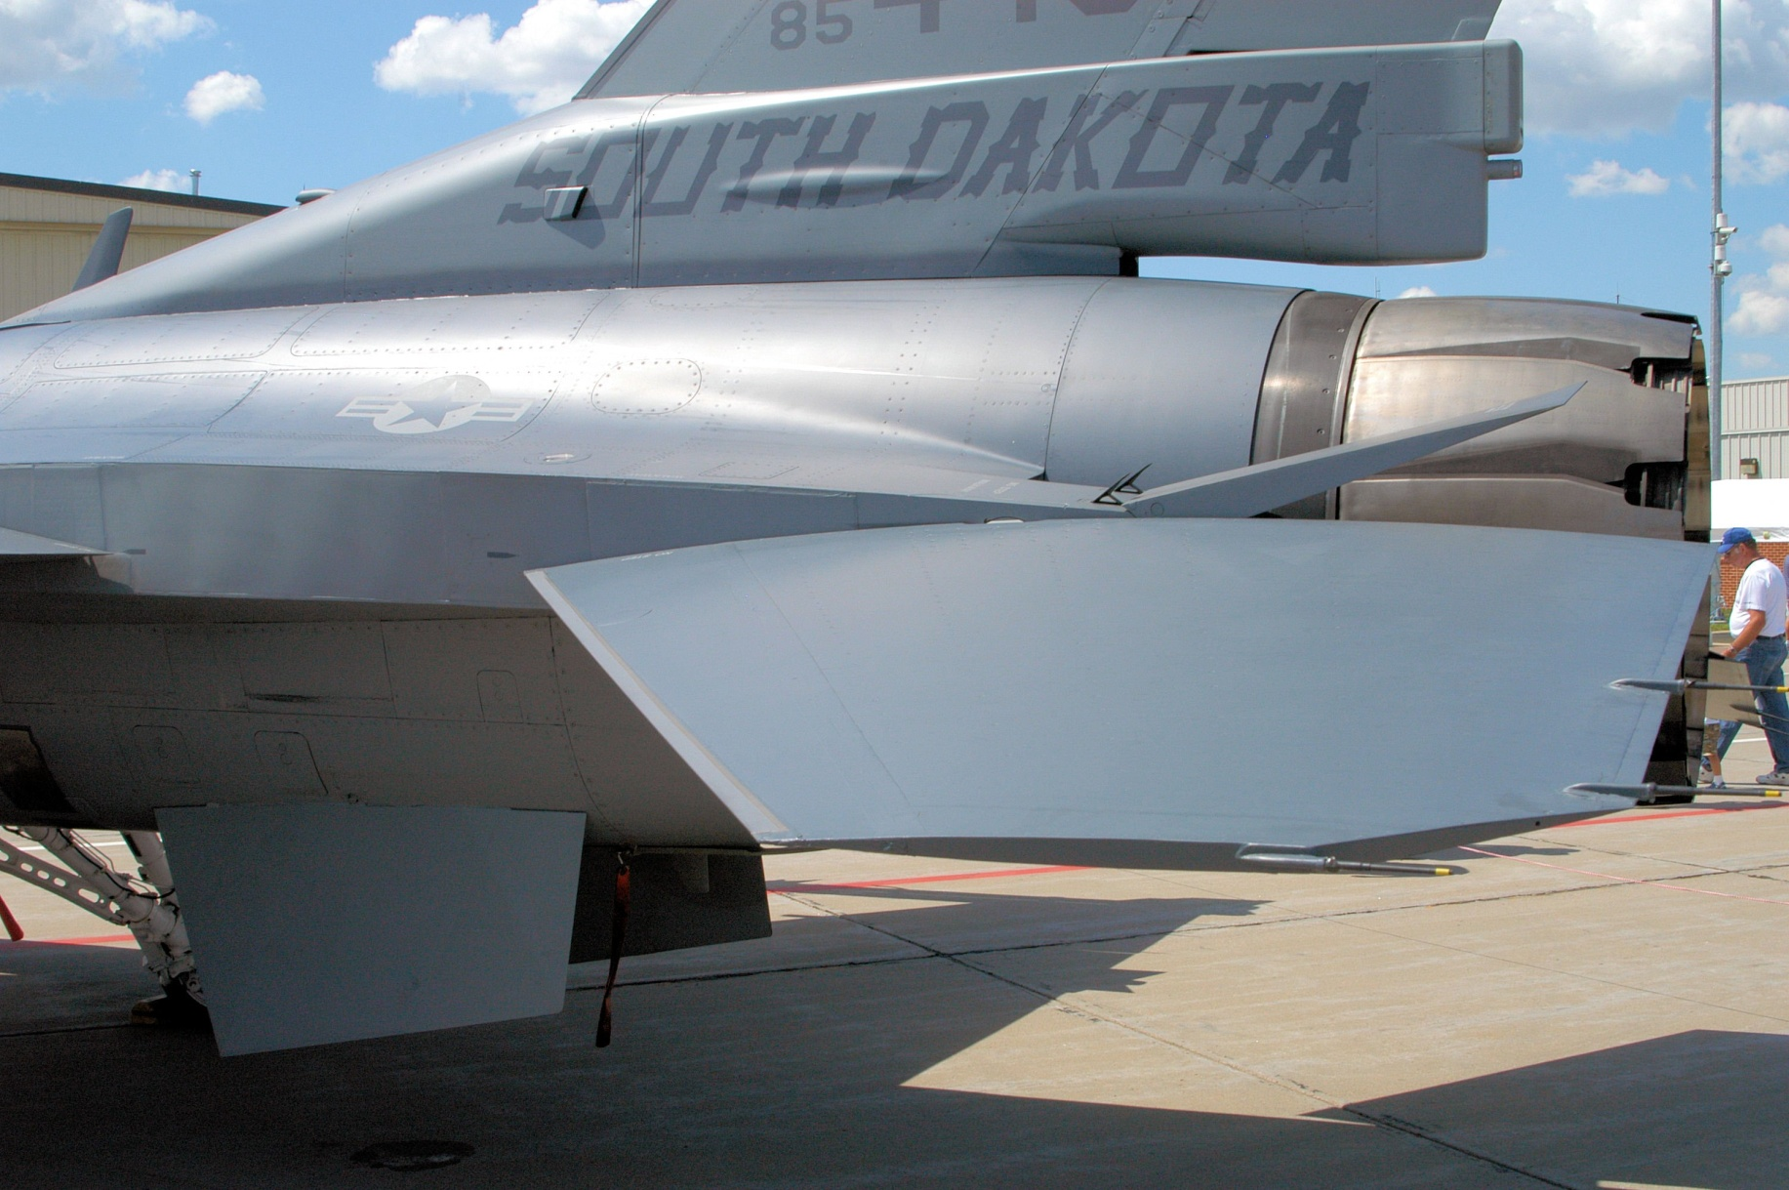
Jet Fighters

Slide 31
Design/Concept
Result of reference use
Strong complete product
Clear, unique look
“Sponsored Fighter” graphics

Slide 32
Modeling
Specs outline
High polycount (20-30.000)
No baked normalmaps
2-3 texturesets max
Agile creation
No bottlenecks/slowdowns
Has to stay fun!

Slide 33
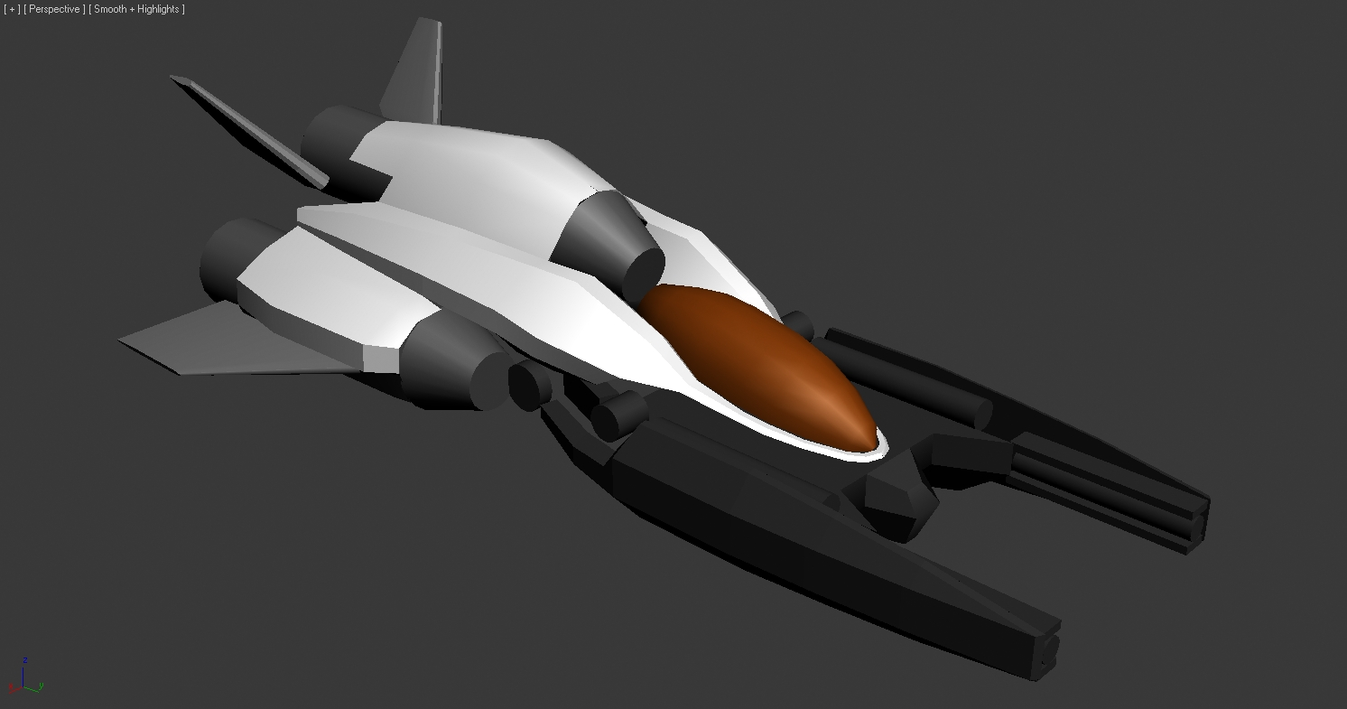
Blockout

Slide 34
Blockout
Blockout is a crucial step
Like a “3D –sketch”:
Look for proportions
See if shapes work together
General lines need to fit

Slide 35
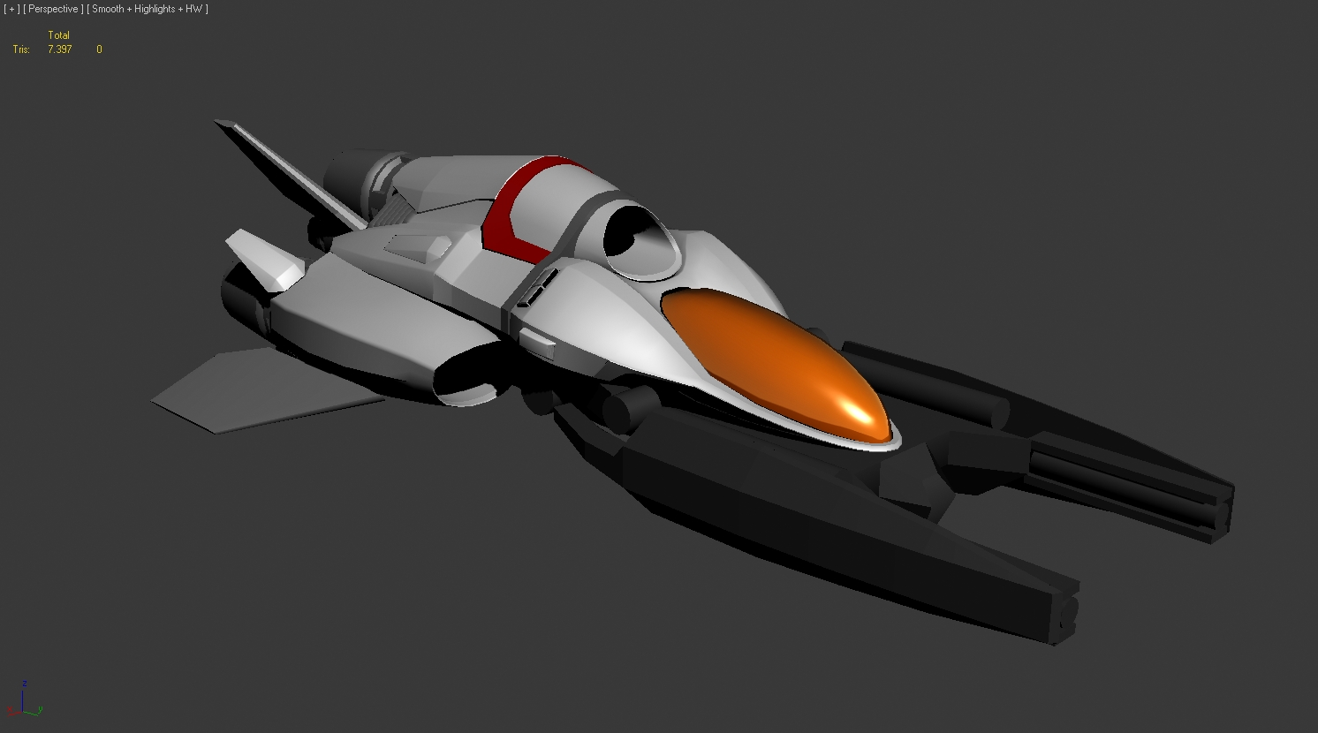
Refine

Slide 36
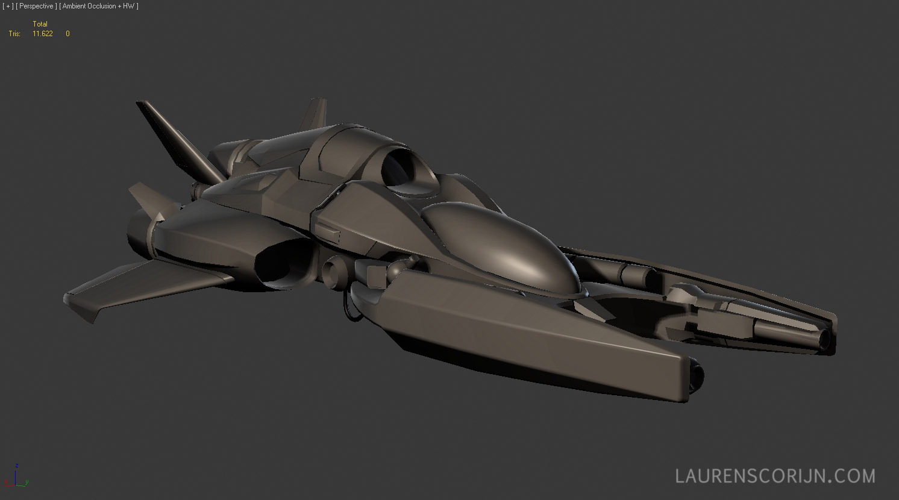
Refine

Slide 37
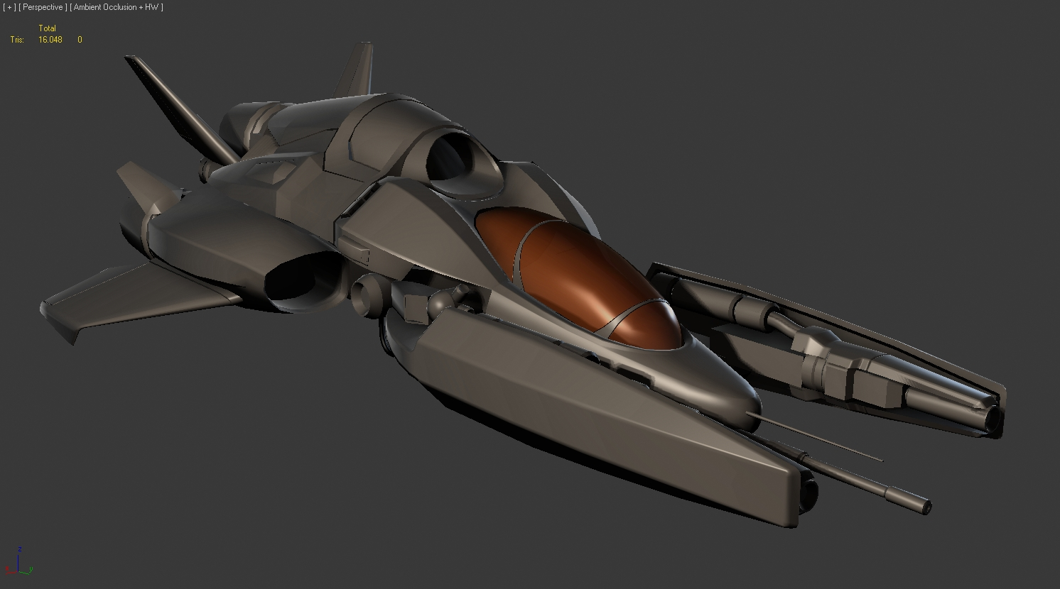
Finish

Slide 38
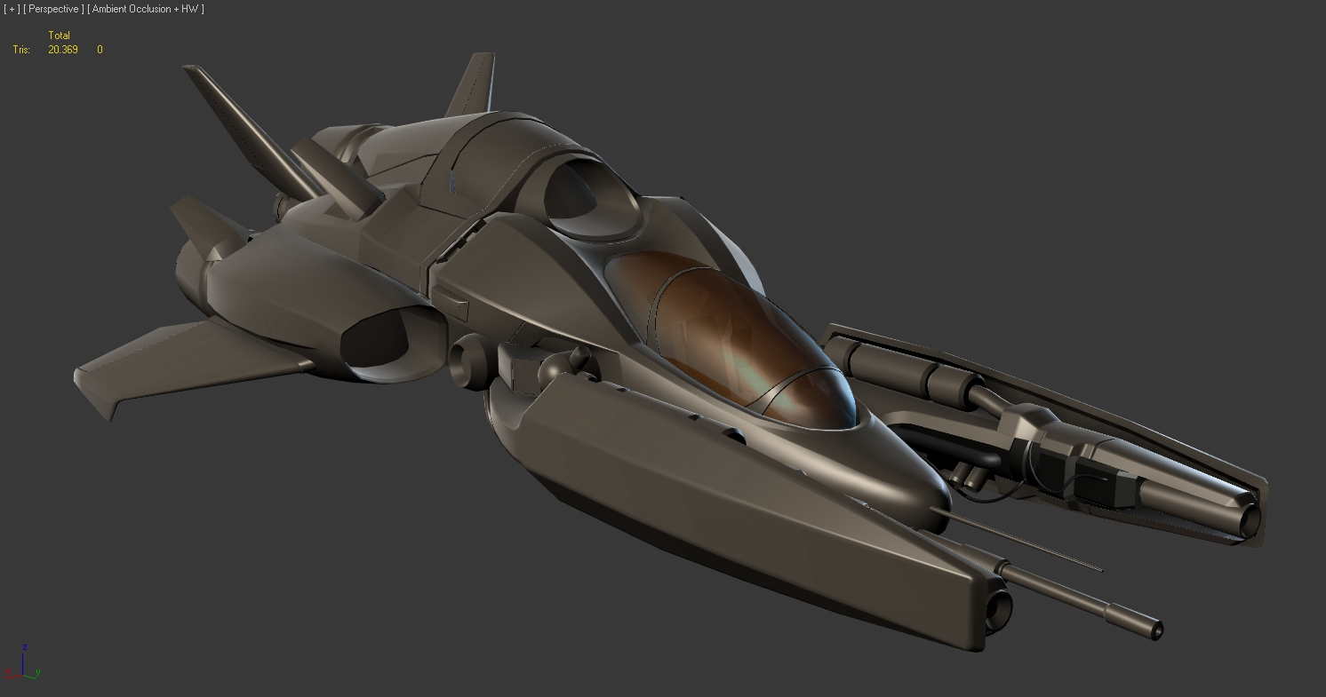
Final details

Slide 39
Mesh Wires & Flow
Focus on optimal shading
Without baked normals
“Midpoly” approach
Forza, Gran Turismo, PGR
Triple edges for chamfers

Slide 40
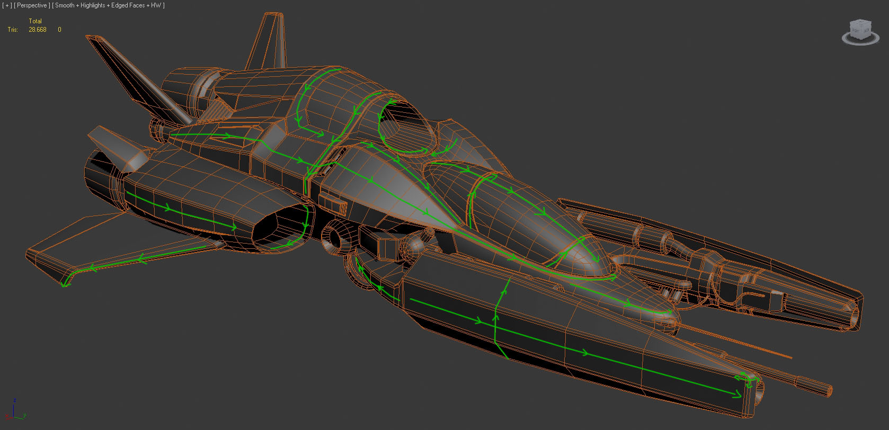
Mesh Wires & Flow

Slide 41
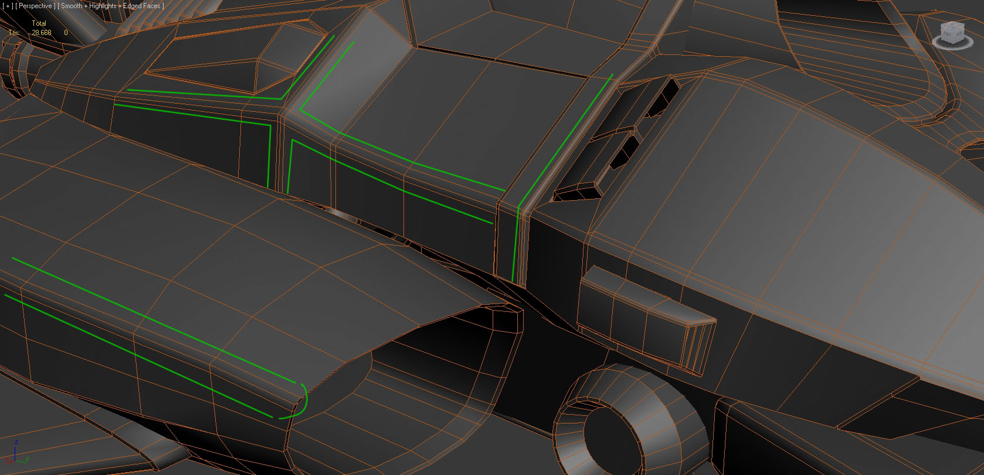
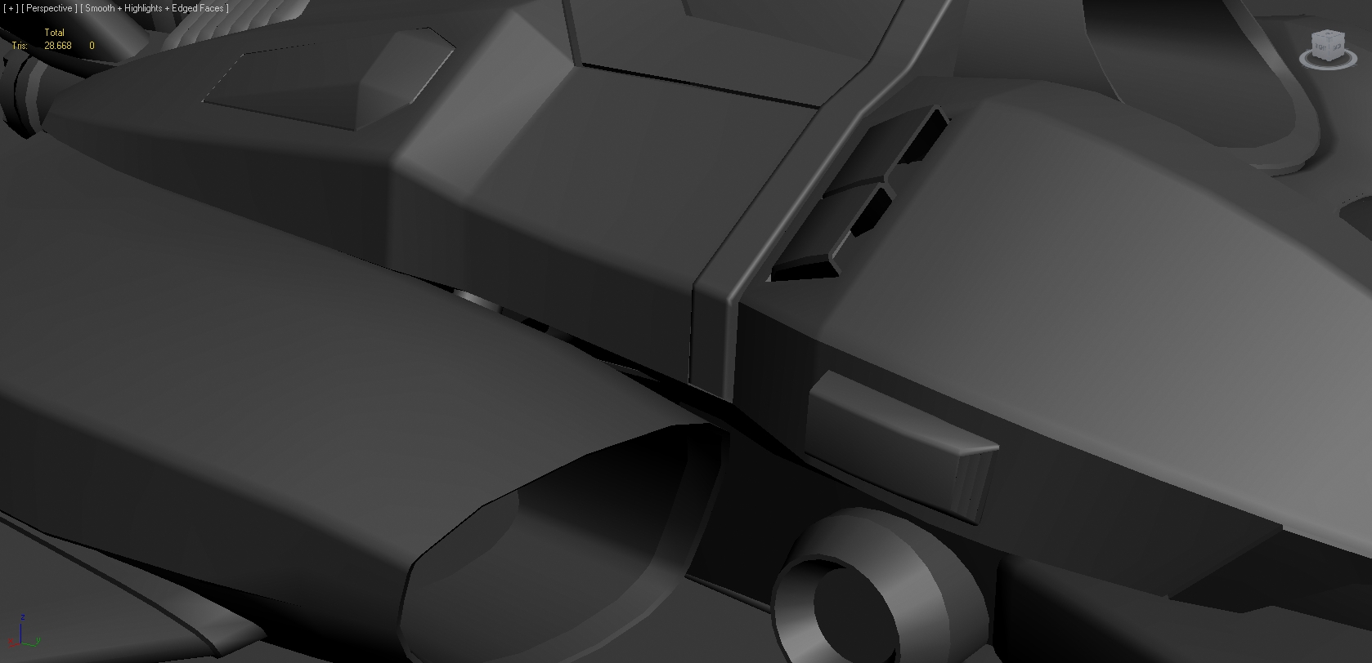
Triple Edges

Slide 42
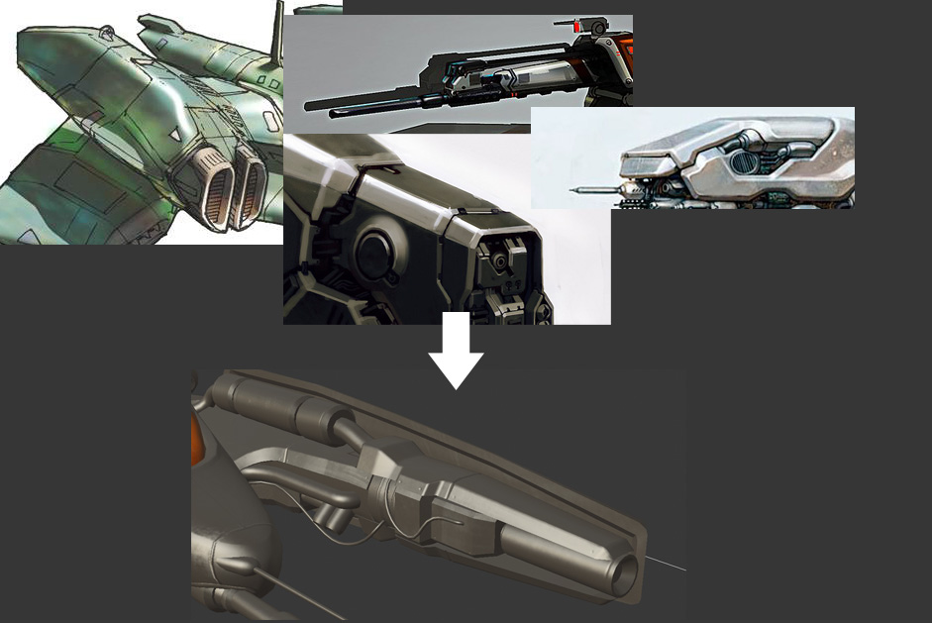
Challenges
Weapon detail proved difficult to fill in
Solution: analyze shape ref

Slide 43
Silhouette
Strong silhouette = better design
Small details
Cables, fins
Multiple angles

Slide 44
Silhouette

Slide 45
Silhouette

Slide 46
Unwrapping
2 Sheets initially
Body – 2048 x 2048 px
Canopy – 256 x 512 px
Transparency sorting
Drawcalls/memory versus sorting

Slide 47
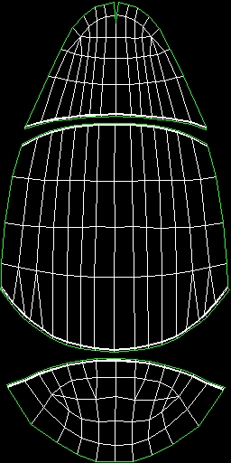
UV Sheets
2048
512

Slide 48
Texture Baking
Ambient Occlusion
No diffuse without!
Baking system choice
3DS Max: slow, bad quality
Xnormal: slow setup & export, fast with GPU
FAOGEN: fast setup, fast bake

Slide 49
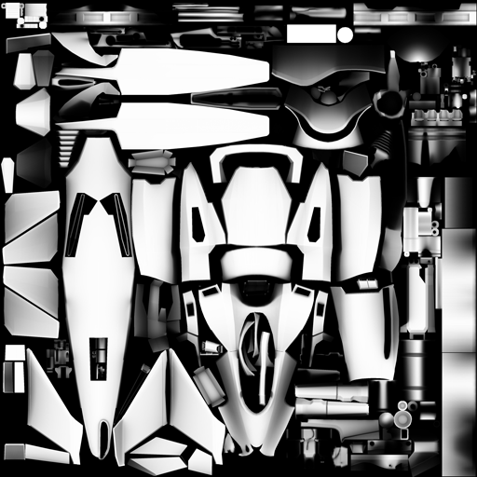
FAOGEN Result

Slide 50
AO result

Slide 51
Gear hatches

Slide 52
Shading problem
Hatch underside opens
Shading is incorrect even with smoothing
Solution is partial bake of smoothed, complete part.

Slide 53
Shading problem

Slide 54
Baking solution

Slide 55
Shading fixed

Slide 56
Normalmap
Details are 2D generated
Using NDo
Advantages NDo:
Dynamic layers
Easy tweaking
Disadvantages:
Slow!
Slower with many layers!

Slide 57
Normalmap Details

Slide 58
Normalmap result

Slide 59
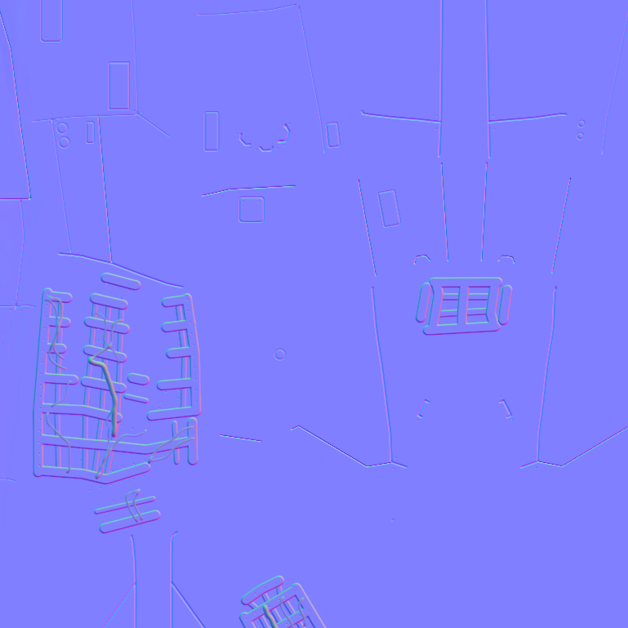
Details in AO
2D normals = no AO baked
Solution: Normals to Cavity

Slide 60
Diffuse Texturing
Ambient Occlusion required
Baked + overlayed Cavity
Normalmap partially required
Makes diffuse texturing easier!

Slide 61
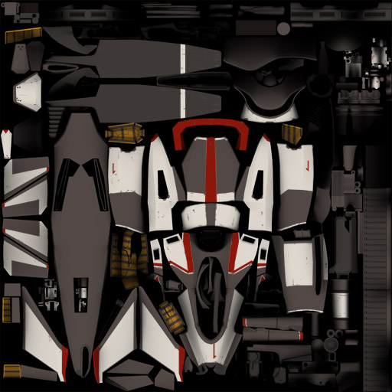
Color Blockout

Slide 62
Aircraft Placards

Slide 63
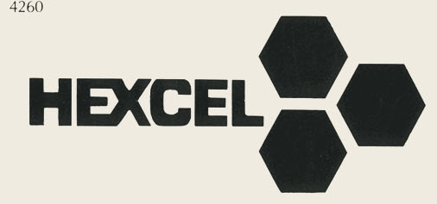
Logo’s

Slide 64
Decals

Slide 65
Key Steps
Use reference!
Accentuate shapes and curves
Contrast in colors
Break up empty areas
Focus on color before wear and tear!

Slide 66
Test Paintscheme

Slide 67
Test Paintscheme

Slide 68
Photoshop Organization
Organize your PSD files from the start
Layer naming
Layer grouping
Layer Masking

Slide 69
Layer Groups
Avoid confusion
Keep oversight
Easy duplication

Slide 70
Masked Layers
Non destructive
Easy selection
Easy tweaking

Slide 71
Wear & Dirt Details
Adding dirt & wear through a few steps
Big overlays
Painted highlights
Panel variations
Smaller details
Placement requires thinking!

Slide 72
No wear

Slide 73
General overlays

Slide 74
Painted Highlights

Slide 75
Panel Variations Dark

Slide 76
… And Light

Slide 77
Small details

Slide 78
Extra detail on exhaust

Slide 79
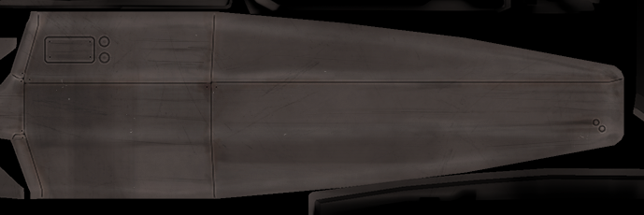
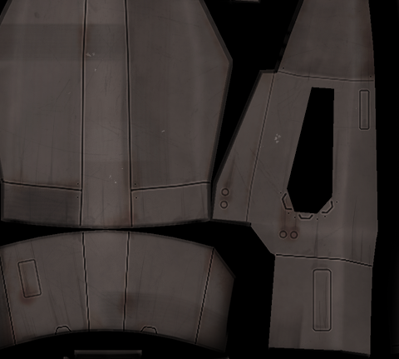
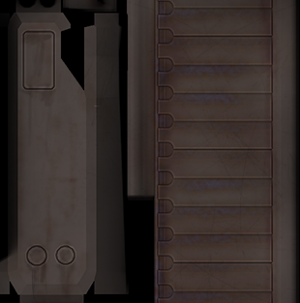
Closeups

Slide 80
Wear out base colors
Paint chips off and wears off too
Use mask layers for wear
Manually paint on edges
Scratches, spots
Faded wear

Slide 81
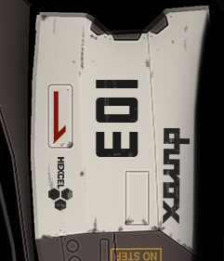
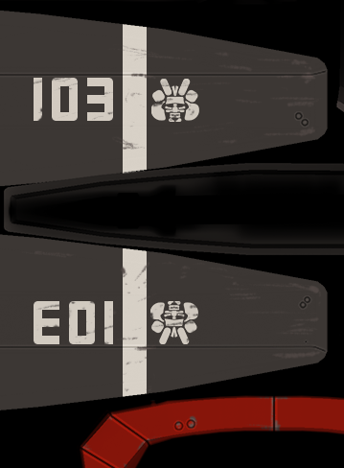
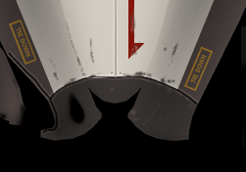
Paint wear closeups

Slide 82
Brushes?
Nothing special was used:
Stamps
“Scratch” brush

Slide 83
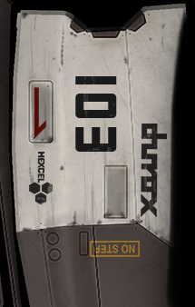
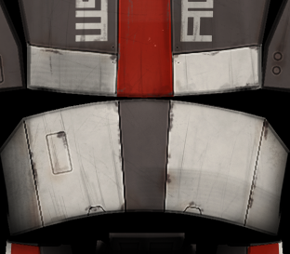
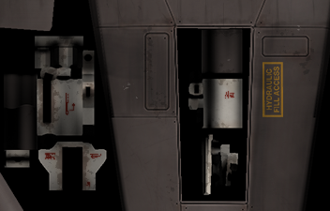
Combined closeups

Slide 84
Diffuse result

Slide 85
Diffuse finish
Diffuse texture should work by itself
100% self illumination
Strong colors and shapes work well
UnSharp Mask afterwards
Once the diffuse is good, move on to
Specular
Glossiness
(Reflect)

Slide 86
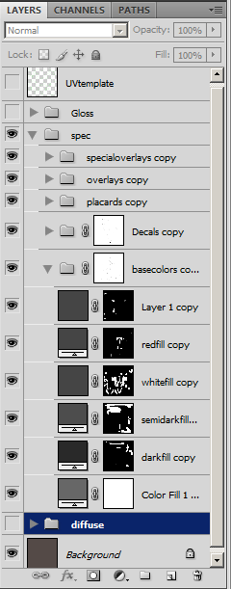
Specular
Duplicate Diffuse folder
Adjust each layer
Remove layers
Add new layers

Slide 87
Specular
Go for CONTRAST!
Specular maps need to be bold
Always use COLOR !
Grayscale is just a waste (DXT1 compress)
Color adds interest in highlights

Slide 88
Specular grayscale

Slide 89
Specular colors

Slide 90
Glossiness
Metal benefits from a Glossmap
Gloss controls highlight sharpness
Can also control reflection blur
Contrast is important!

Slide 91
Glossmap result

Slide 92
Glossmap creation
Glossmap is simply created from the spec
Remove saturation
More contrast
Add details if necessary

Slide 93
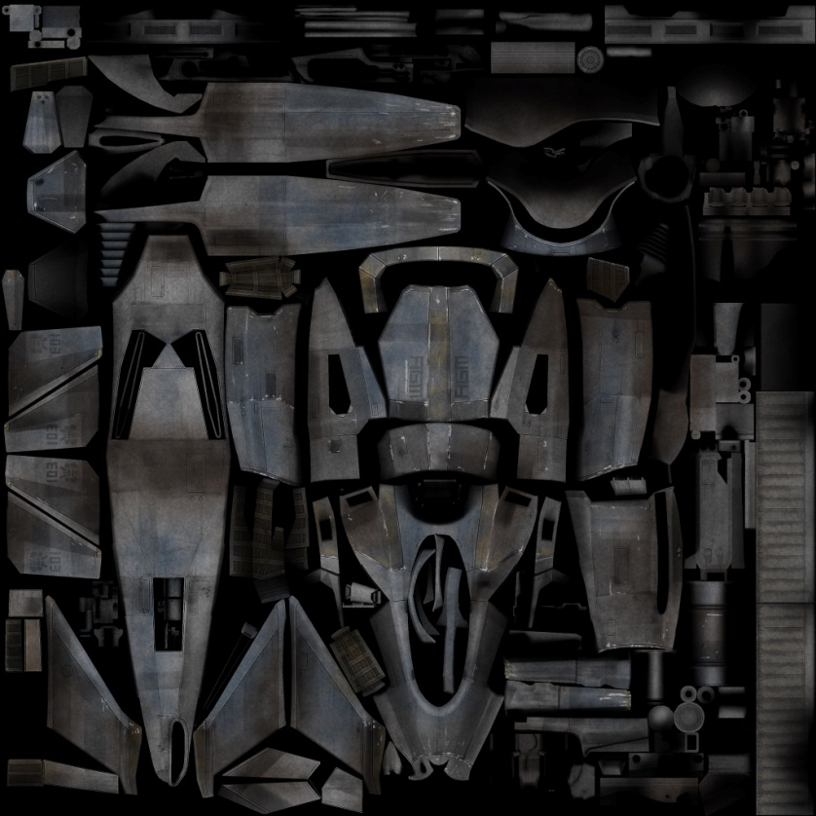
AO on Spec/Gloss?
VS

Slide 94
AO on Spec/Gloss?
Ambient Occlusion = amount of light
No light = no spec/reflection
Gloss is not reflection strength
Only a “blur value”

Slide 95
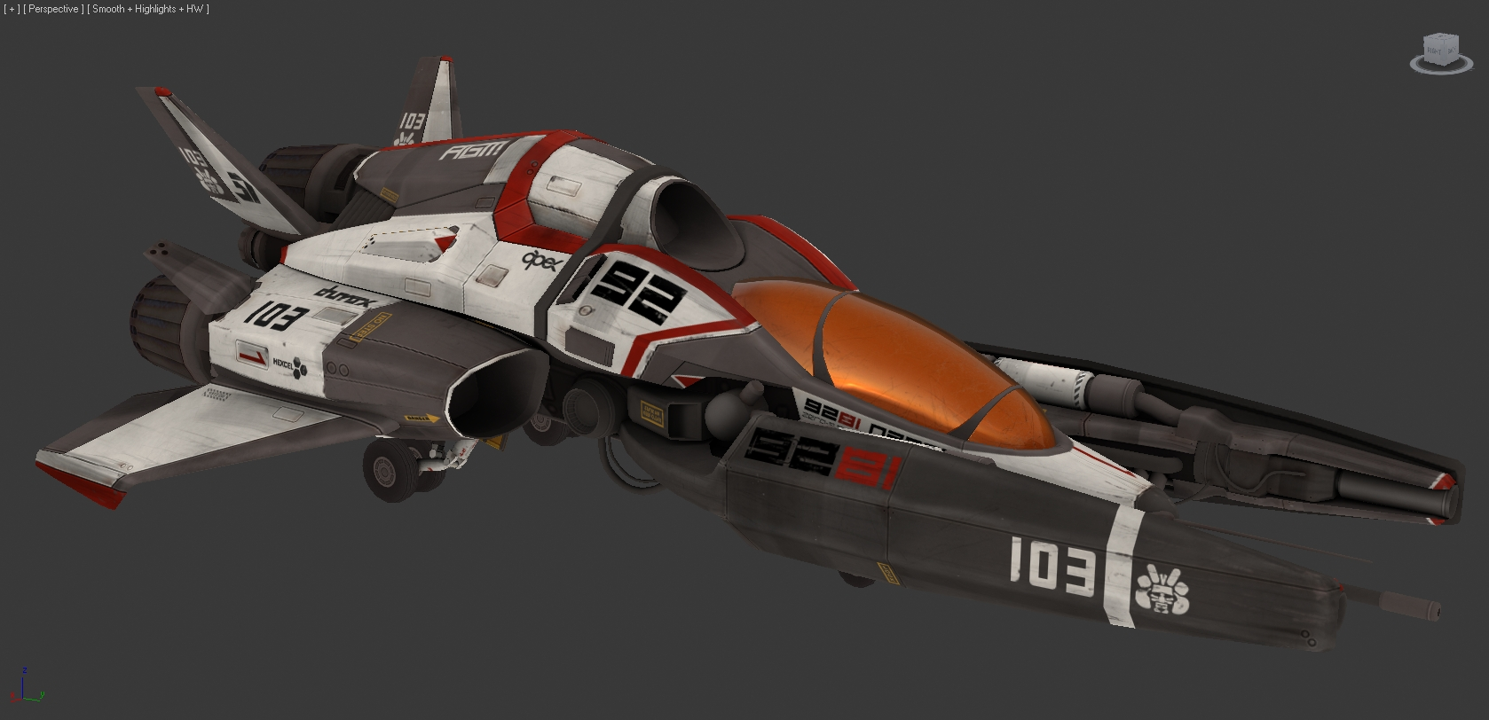
Spec/Reflect/Gloss result

Slide 96
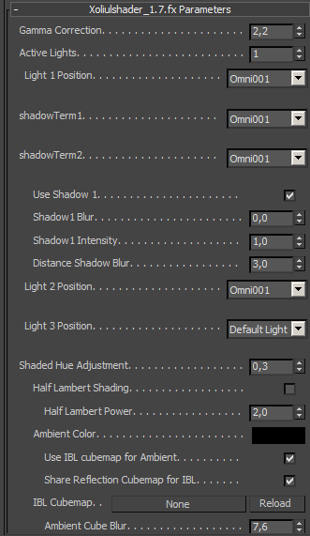
Max Setup ?
Viewport Shader: Xoliulshader 1.7
Realtime result
Easy map previewing
Lots of control
Better than rendering!

Slide 97
3DS Max only?
Shader is also ported to Maya as v1.5
Maya interface is less optimized
Alternatives: Marmoset Toolbag
Downside:external application
Requires export

Slide 98
Finishing touches
Canopy texture
Quick, easy: small texture
Parameter tweaks to get glass look
Opacity map!
Interior
Silhouette only
AO texture only

Slide 99
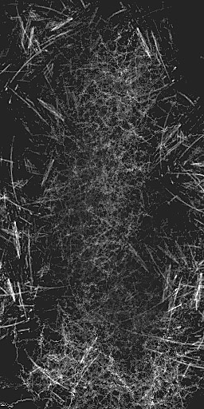
Canopy textures
Diffuse
Opacity
Spec/Reflect

Slide 100
Canopy result

Slide 101
Interior result

Slide 102
Art finished
Art creation aspect is done
Implementation is up next
Art presentation I do at this point

Slide 103
Custom Logo

Slide 104
Final Presentation Image

Slide 105
Environment & Effects
Next Up: space environment & Effects
More complete presentation
Effects & Enviro in UDK

Slide 106
Effects
Spaceship allows for crazy effects
Lasers
Boosters/Thrusters
Shields
“atmospheric re-entry”

Slide 107
Booster effect

Slide 108
Re-Entry effect

Slide 109
Re-Entry effect

Slide 110
Environment
Inspired by Halo: Reach
Planet with nebula’s
Strong colors
Contrast!

Slide 111
Halo: Reach

Slide 112
Halo: Reach

Slide 113
Planet Surface

Slide 114
Panet Surface
Special shader with layers:
Ground surface
Water
Clouds

Slide 115
Planet Surface

Slide 116
Planet Surface: water

Slide 117
Planet Surface: clouds

Slide 118
Atmosphere Layer

Slide 119
Nebula Layers

Slide 120
Nebula Textures

Slide 121
Nebula’s Result

Slide 122
Nebula’s Result

Slide 123
Skybox
Generated using “SpaceScape”

Slide 124
Skybox result

Slide 125
Final Images

Slide 126
Final Images

Slide 127
Final Images

Slide 128
Final Images

